Slide 1
Object-Oriented Programming with Java
P TEJASWINI REDDY

Slide 2

Introduction
In this presentation , we can know how to build robust and scalable applications using Java's Object-Oriented Programming paradigm. It covers the fundamental concepts of OOP, such as inheritance, polymorphism, and encapsulation, and how they can be leveraged to create high-quality software. We will also explore advanced topics, including design patterns, refactoring, and testing. By the end of this presentation, you will have a solid understanding of how to develop Java applications that are both maintainable and extensible.

Slide 3
OOPS WITH JAVA
Object-Oriented Programming is a programming paradigm that emphasizes the use of objects to represent real-world entities and concepts. It provides a way to organize code into reusable and modular components, making it easier to develop and maintain complex software systems. OOP is based on four key principles: encapsulation, abstraction, inheritance, and polymorphism. These principles help to create code that is more modular, flexible, and easier to understand.

Slide 4

In Java, a class is a blueprint for creating objects. A class defines the properties and behaviors that an object will be given have. An object is an instance of a class, with its own unique set of properties and behaviors based on the class. In OOP, objects are used to represent real-world entities and concepts. For example, a Person class might have properties such as name, age, and address, and behaviors such as walk() and talk(). Objects of this class would represent individual people, with their own unique values for these properties.

Slide 5
INHERITANCE
Inheritance is a mechanism in OOP that allows a class to inherit properties and behaviors from another class from anywhere. The class that is being inherited from is called the super class, and the class that is inheriting is called as subclass. Inheritance allows for code reuse and makes it easier to create new classes that are similar to existing ones. It also allows for more modular and flexible code, as changes made to the super class will affect all subclasses that inherit from it.

Slide 6
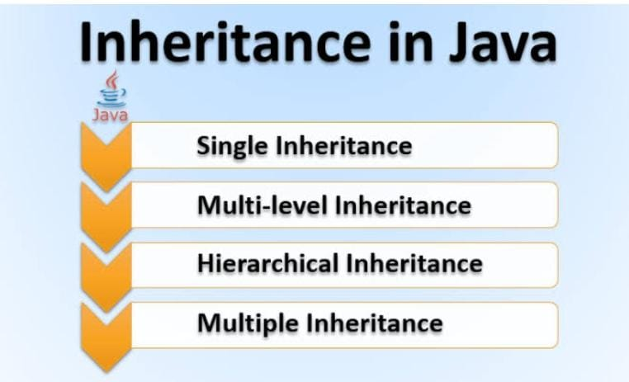
INHERITANCE

Slide 7
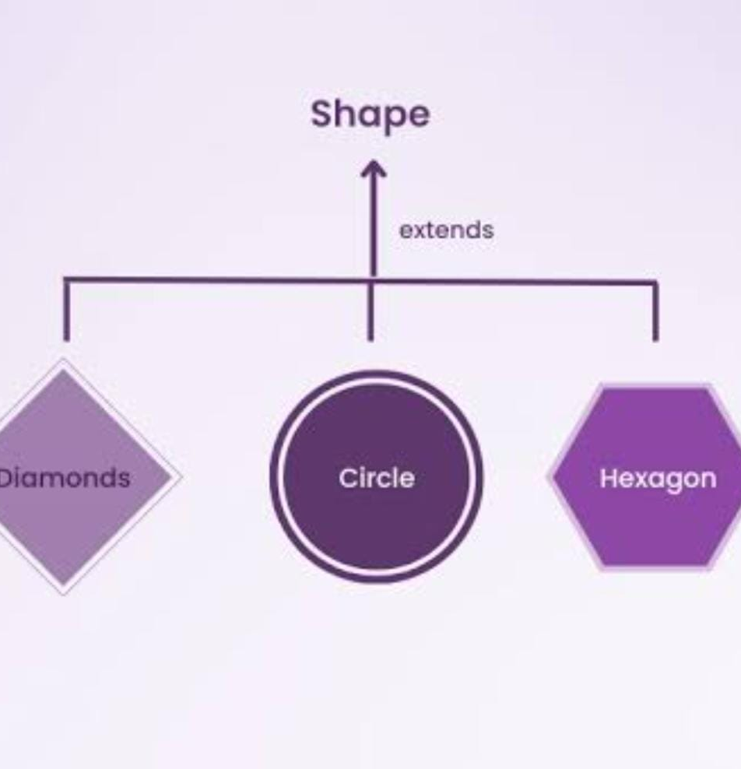
ABSTRACTION
Abstraction is the process of identifying essential features of an object and ignoring the non-essential ones. This allows for the creation of simpler and more modular code that is easier to understand and maintain. In Java, abstraction is often achieved through the use of interfaces and abstract classes. These provide a way to define a set of common behaviors that can be shared across multiple classes, without specifying the details of how those behaviors are implemented.

Slide 8
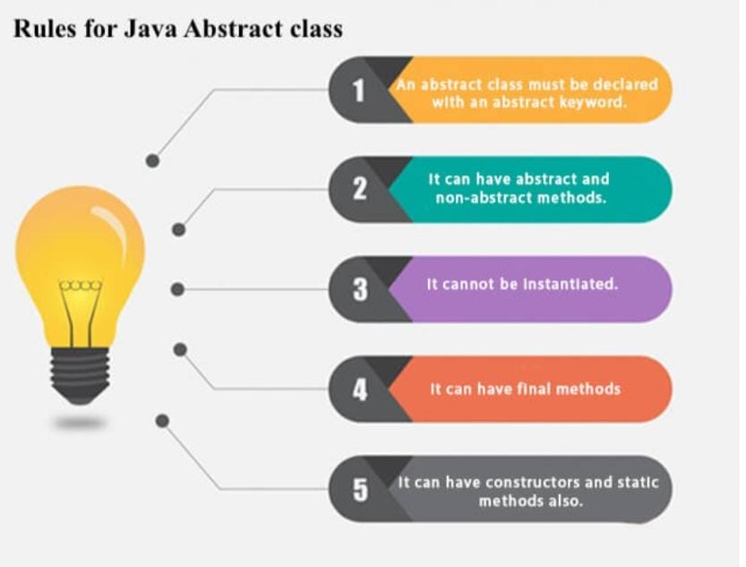
ABSTRACTION
Advantages of abstraction
is high we can have final
methods with it and can not
be instantiated , can have
constructors ,methods,static.

Slide 9
ENCAPSULATION
Encapsulation is hiding the internal details of an object (behavior) and providing a public interface for accessing and modifying its state. This helps to ensure that the object remains in a consistent and valid state, and prevents outside code from accidentally modifying its internal state. Encapsulation is achieved in Java through the use of access modifiers, such as public, private, and protected whereas default is by default. These modifiers control what parts of an object's state and behavior can be visible and accessible to other parts of the code.

Slide 10
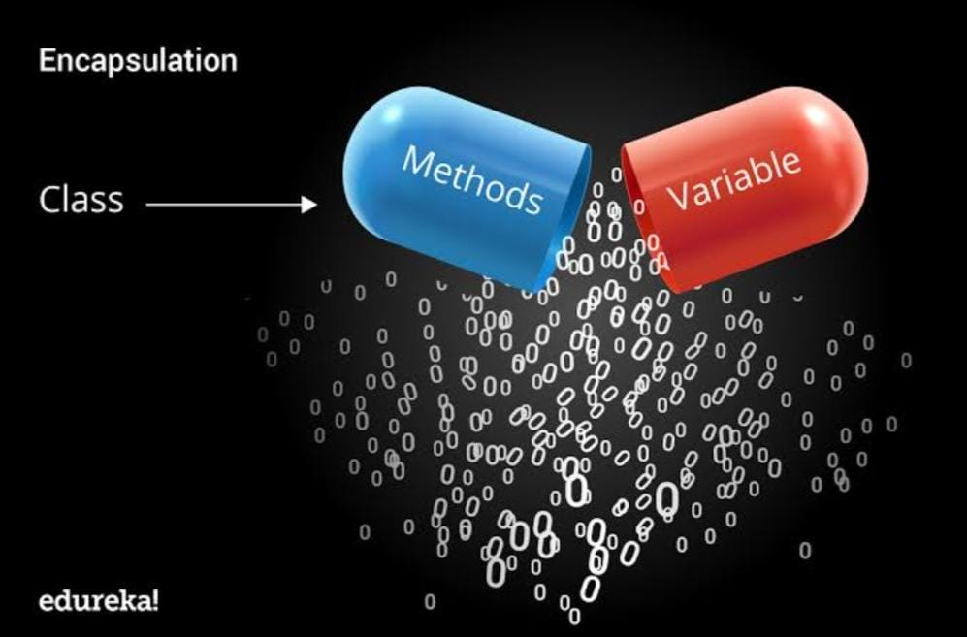
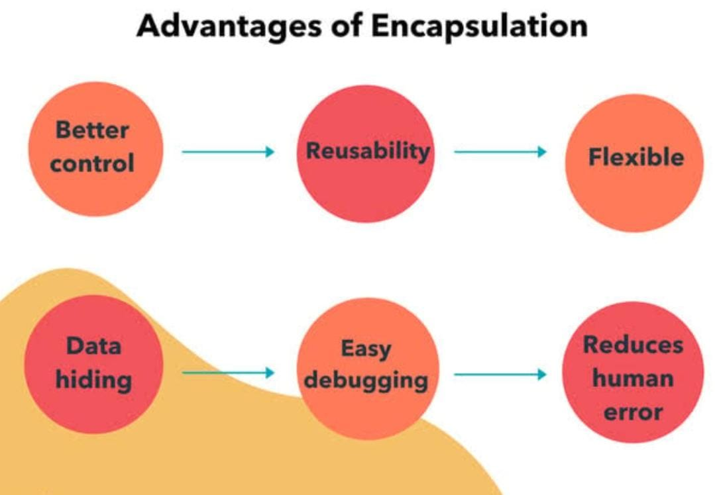
ENCAPSULATION

Slide 11
METHOD OVERLOADING
Method overloading is the process of defining multiple methods with the same name but different parameters.
It can be used only if we have different parameters quantity or types.

Slide 12
METHOD OVERRIDING
Method overriding is the process of redefining a method in a subclass that is already defined in it’s the parent class.
This concept is used to give same name and parameters but in child class.

Slide 13


REFACTORING
Refactoring is the process of improving the design and structure of the code, without changing its external behavior. Refactoring can help to make code more modular, extensible, and easier to understand. Some common refactoring techniques include renaming variables, extracting methods, and simplifying conditionals. Refactoring should be done regularly as part of the development process, to ensure that code remains maintainable and easy to work with.

Slide 14
Design patterns are reusable solutions to common software design problems. They provide a way to solve problems that have been encountered before, without having to doing it again. Many design patterns are based on OOP principles, such as inheritance, polymorphism, and encapsulation. Some common design patterns include the Singleton, Factory Method and Observer patterns.
DESIGN
PATTERN

Slide 15

TESTING
Java provides a framework called JUnit to perform the unit testing in our Java code. In the development of test-driven development, JUnit is very crucial.It is a crucial part of developing robust and scalable Java applications. Testing helps to ensure that code is working as intended, and that changes made to the code do not introduce any new bugs or issues to it. There are several types of testing that can be done, including unit , integration, and acceptance testing. By using a combination of these testing techniques, developers can create code that is more reliable and easier to maintain.

Slide 16

BEST PRACTICE
There are several best practices that should be followed by developers in Java applications using OOP principles. These include: writing modular and reusable code, following the Single Responsibility Principle, using descriptive and meaningful names for classes and methods, and avoiding code duplication. By following these best practices, developers can create code that is easier to read, maintain, and extend.

Slide 17
REAL WORLD APPLICATIONS
Java's OOP features are used in a wide variety of real-world applications, from web applications to video games to enterprise software world. By using OOP principles, developers can create code that is easier to maintain, extend, and reuse. Some notable Java applications that use OOP include the Spring Framework, Hibernat. By learning OOP with Java, developers can gain valuable skills that are in high demand in the industry of software .

Slide 18

CHALLENGES FACED
While OOP can help to create more modular and flexible code, it also gives several challenges and opportunities. Some of the challenges include: complexity, performance considerations, and learning . However, OOP also presents several opportunities, such as: code reuse, modularity, and extensibility. By understanding these challenges and opportunities mentioned above, developers can make informed decisions about when and how to use OOP in their software projects.

Slide 19
CONCLUSION
In this presentation, we have explored the fundamental concepts of Object-Oriented Programming with Java. We have discussed the key principles of OOP, such as inheritance, polymorphism, and encapsulation, abstraction and how they can be used to create high-quality software . Also about method overriding and overloading. We have also explored advanced topics, such as design patterns, refactoring, and testing. By following best practices and considering performance implications, developers can create Java applications that are both robust and scalable.

Slide 20
THANK YOU
Contact me:
tejaswinireddypedarapu@gmail.com

